Slide 1
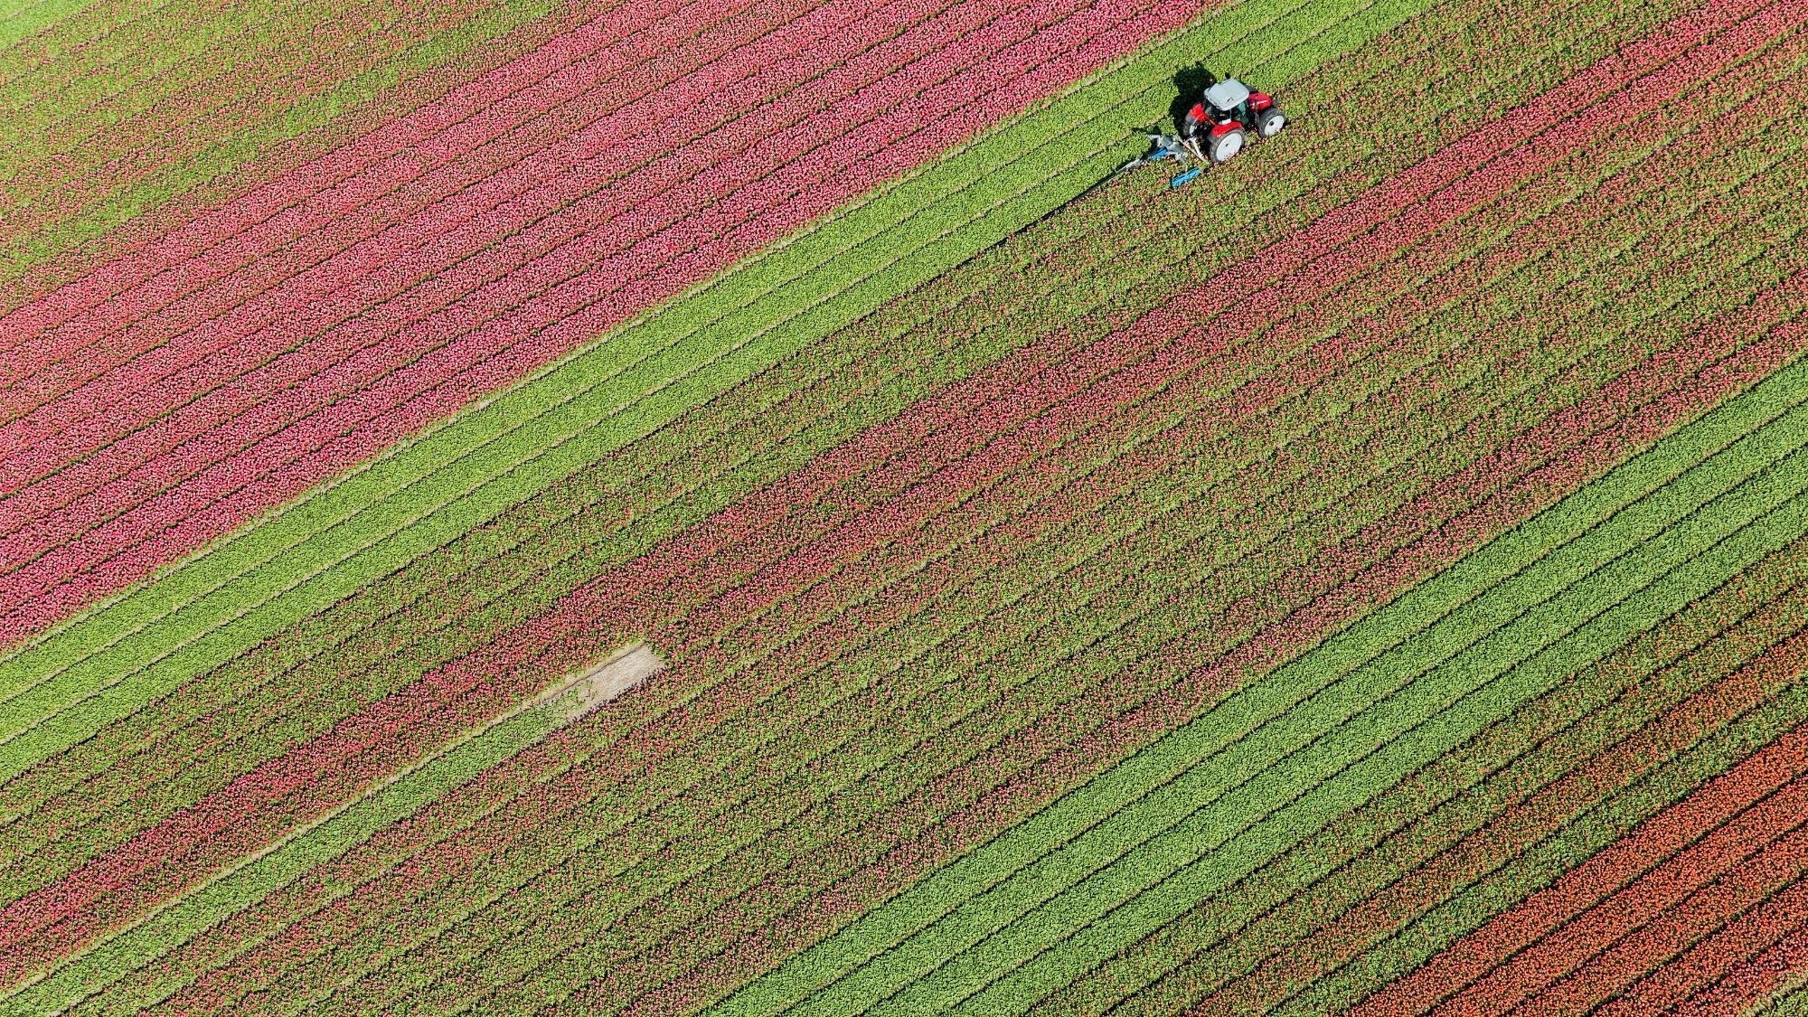
Agricultural Crop Recommendation System using Machine Learning: Recommending based on the Environmental Aspects of a Specific land
Thriloke N(210701291)
Vaishnav Kumar G(210701297)
Suriya Sundaram K S(210701272)

Slide 2
ABSTRACT
We aim to develop machine learning models that recommend optimal crops based on soil conditions to help farmers minimize losses and maximize profits. Our system will use a dataset containing values of nitrogen, phosphorus, potassium, soil pH, temperature, and rainfall. By analyzing these parameters, we can predict the best crops for specific regions, enabling informed farming decisions.

Slide 3
INTRODUCTION
Agriculture is the basic source of food supply of all the countries of the world—whether underdeveloped, developing or even developed. The world population is estimated to be about 9.7 billion by 2025. This added with unpredictable weather conditions makes it difficult to ensure food sustainability. Fortunately there is a solution for this problem as for many others. Crop Recommendation System takes the N-P-K (Nitrogen, Phosphorous and Potassium) and pH values along with the temperature, humidity values as input and recommends the optimal crop to the farmer, hence ensuring that the farmer takes an informed decision before cultivation. In this system , we train the model using Random Forest , Decision Tree and KNN neighbor . We compare the accuracy of this models and choose the best out of it and store that specific model using pickle module and deploy the machine learning model using Flask. A user can input the various parameters like Nitrogen , Phosphorous , potassium , PH value , Rainfall and Location by interacting with user interface to predict the appropriate crop.

Slide 4
LITERATURE SURVEY
SI.NO | NAME OF THE PAPER | AUTHOR | YEAR | REVIEW
1. | An Acquisition Based Optimised Crop Recommendation System with Machine Learning Algorithm | Choudhury, S. S., Pandharbale, P. B., Mohanty, S. N., & Jagadev, A. K. | 2024 | The agricultural sector makes a significant economic impact in India. It contributes 19.9% to the national GDP. The prosperity of the country's economy greatly affects the country's progress and the quality of life for Indian citizens. The vast majority of farms still use antiquated methods rather than adopting a data-driven strategy to increase output and earnings. It is considered a cornerstone of India's financial structure. Since achieving independence, increasing output through the implementation of cuttingedge technologies has been a top priority
2. | Intelligent Crop Recommender System for Yield Prediction Using Machine Learning Strategy. | Maheswary, A., Nagendram, S., Kiran, K. U., Ahammad, S. H., Priya, P. P., Hossain, M. A., & Rashed, A. N. Z. | 2024 | For most developed nations, agriculture is a significant economic force. The realm of contemporary agriculture is consistently growing with evolving farming techniques and agricultural innovations. Farmers face challenges in keeping pace with the evolving demands of the planet and meeting the requirements of profitable initiatives, characters, and various other stakeholders.
3. | Red fox optimization with ensemble recurrent neural network for crop recommendation and yield prediction model. | y Gopi, P. S. S., and M. Karthikeyan | 2024 | Precision agriculture concentrates on monitoring (sensing technologies), management information system, variable rate technologies, and responses to inter- and intravariability in cropping systems. The advantages of precision agriculture involve improving crop productivity and crop quality with minimum environmental impact. Crop yield prediction (CYP) is one of the challenging tasks in agriculture, which mainly depends upon soil, meteorological, environmental, and crop-related variables.
4. | Data-Driven Analysis and Machine Learning-Based Crop and Fertilizer Recommendation System for Revolutionizing Farming Practices | Musanase, C., Vodacek, A., Hanyurwimfura,D.,Uwitonze, A., & Kabandana | 2022 | Agriculture plays a key role in global food security. Agriculture is critical to global food security and economic development. Precision farming using machine learning (ML) and the Internet of Things (IoT) is a promising approach to increasing crop productivity and optimizing resource use. This paper presents an integrated crop and fertilizer recommendation system aimed at optimizing agricultural practices in Rwanda.

Slide 5
LITERATURE SURVEY
SI.NO | NAME OF THE PAPER | AUTHOR | YEAR | REVIEW
6. | Contrastive learning for sequential recommendation | Xie, X., Sun, F., Liu, Z., Wu, S., Gao, J., Zhang, J., ... & Cui, B | 2022 | Sequential recommendation methods play a crucial role in modern recommender systems because of their ability to capture a user's dynamic interest from her/his historical inter-actions. Despite their success, we argue that these approaches usually rely on the sequential prediction task to optimize the huge amounts of parameters. They usually suffer from the data sparsity problem, which makes it difficult for them to learn highquality user representations
7. | IoT framework for measurement and precision agriculture: predicting the crop using machine learning algorithms | Bakthavatchalam, K., Karthik, B., Thiruvengadam, V., Muthal, S., Jose, D., Kotecha, K., & Varadarajan, V | 2022 | IoT architectures facilitate us to generate data for large and remote agriculture areas and the same can be utilized for Crop predictions using this machine learning algorithm. Recommendations are based on the following N, P, K, pH, Temperature, Humidity, and Rainfall these attributes decide the crop to be recommended. The data set has 2200 instances and 8 attributes. Nearly 22 different crops are recommended for a different combination of 8 attributes. At present, many advancements have been made in recent times, starting from crop selection to crop cutting.
8. | Artificial neural networks based integrated crop recommendation system using soil and climatic parameters | Madhuri, J., & Indiramma, M | 2021 | To develop crop recommendation system depending on locationspecific soil and climatic conditions. Method: The study introduces a novelrecommendation system which uses Artificial Neural Networks (ANN) forrecommending the suitable crop. The crops are recommended based on (a) Soilproperties (b) Crop characteristics (c) Climate parameters. The crops namelymaize, Finger millet, Rice and sugarcane is considered for the study. Dependingon degree of relationship and limitations of the factors considered, followingsuitability classes are established: (a) Highly suitable: S1 (b) Moderately suitable:S2 (c) Marginally suitable: S3 (d) not suitable.

Slide 6
LITERATURE SURVEY
SI.NO | NAME OF THE PAPER | AUTHOR | YEAR | REVIEW
9. | Impact of machine learning techniques in precision agriculture. In 2020 3rd International Conference on Emerging Technologies in Computer Engineering. | y Katarya, R., Raturi, A., Mehndiratta, A., & Thapper, A. | 2020 | Agriculture and its accessories contribute to approximately 17% of India's GDP and it is still the most popular occupation amongst 70% of India's population. The agriculture sector provides different outputs used by diverse segments which include, but not limited to, use as raw materials by different industries, sources of nutrition and businesses, etc. However, the different methods used for growing crops are still mostly traditional and even borderline outdated.
10. | A fuzzy logic-based crop recommendation system. In Proceedings of International Conference on Frontiers in Computing and Systems. | Banerjee, G., Sarkar, U., & Ghosh, I. | 2021 | Soil, geographical and meteorological parameters have major impacts on sustained crop production. Most of the rural farmers have no adequate knowledge about the effects of these parameters on crop production. The rural farmers generally rely on their traditional knowledge to select a crop which often leads to huge economic loss. A scientific system considering these site-specific parameters along with the traditional knowledge of the farmers may be an effective solution. This paper suggests a fuzzy logic-based crop recommendation system to assist rural farmers.

Slide 7
EXISTING SYSTEM
The main challenge faced in agriculture sector is the lack of knowledge about the changing variations in climate. Each crop has its own suitable climatic features. This can be handled with the help of precise farming techniques. The precision farming not only maintains the productivity of crops but also increases the yield rate of production. The existing system which recommends crop yield is either hardware-based being costly to maintain, or not easily accessible. Despite many solutions that have been recently proposed, there are still open challenges in creating a user-friendly application with respect to crop recommendation.

Slide 8
PROPOSED SYSTEM
Our system tackles crop selection for farmers. It analyzes environmental factors to recommend high-yielding, profitable crops. Unlike existing solutions, ours goes beyond yield to consider profit potential. By predicting yield based on user-provided data like nitrogen, phosphorus, potassium, temperature, humidity, PH value and rainfall in mm system empowers farmers to maximize production and income, ensuring food security.

Slide 9
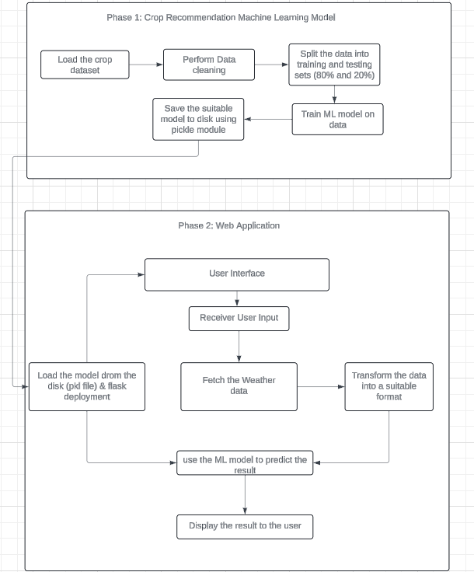
ARCHITECTURE

Slide 10
MODULES
Data Collection
Data preprocessing and Feature Extraction
Training the Random Forest Classifier
Testing the Model
Recommend Crops

Slide 11
MODULES
Data Collection: The dataset containing images of various in is collected from Kaggle. In total the dataset consist 22 different types of crops with environment aspects.
Data Preprocessing and Feature Extraction: The dataset is splitted into test and train sets. Then the data is passed to machine learning model where the machine learning model predicts the crop for recommendation system.
Training the model: The features extracted from the dataset is used to train the model.
Testing the Model: The trained model is tested using the test dataset to determine the performance of the model against unseen insect images.
Recommend Crop: Based on the user input, the model recommend suitable crop.

Slide 12
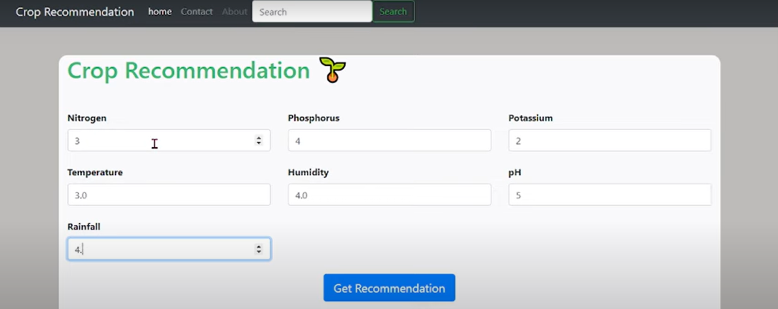
OUTPUT SCREENSHOT

Slide 13
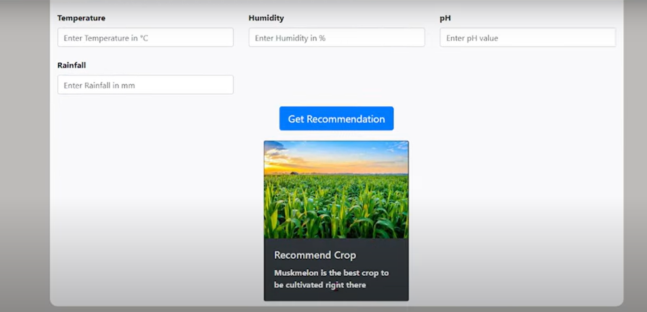
OUTPUT SCREENSHOT

Slide 14
RESULT AND DISCUSSION
The crop recommendation system website was made using HTML, CSS and JavaScript in the frontend and Flask framework in the backend. The website front end was made using the Materialize CSS framework. We have used HTML forms to capture the input data from the user. The ‘Recommend Crop’ button is a submit button that uses the HTTP POST method which sends the data to the python Flask. It takes humidity and temperature values from the user as input, then the model predicts the crop for production then, the model recommends the crop for farming to get the maximum yield , which alternatively gets maximum profit.

Slide 15
CONCLUSION
The Crop Recommendation System is mainly used to recommend the optimal crop to the Farmer. With many industries going digital, it is important that the agricultural sector also take advantage of the various technologies by using them to solve problems faced by the farmers. Using the approach that we discussed, farmers can expect greater yields. This system can be integrated with other smart agricultural systems that already exist. It is cost efficient and helps the farmers make an informed decision.

Slide 16
FUTURE ENHANCEMENTS
Enhancing the system with the market-demand products: Connect the recommendation system to database where the market-demand products and seasonal fruits to get the max profit from the yield of the recommended crop for the production.
Enhanced User Experience: Develop a mobile app for easy field access and data collection, Integrate a crop management system to provide guidance on planting, irrigation, and pest control based on the chosen crop, create a farmer community forum for knowledge sharing and peer-to-peer support.

Slide 17
REFERENCES
[1] Bakthavatchalam, K., Karthik, B., Thiruvengadam, V., Muthal, S., Jose, D., Kotecha, K., & Varadarajan, V. (2022).” IoT framework for measurement and precision agriculture: predicting the crop using machine learning algorithms”. Technologies, 10(1), 13.
[2] Pandey, A., & Jain, K. (2022). “An intelligent system for crop identification and classification from UAV images using conjugated dense convolutional neural network”. Computers and Electronics in Agriculture, 192, 106543.
[3] Banerjee, G., Sarkar, U., & Ghosh, I. (2021).” A fuzzy logic-based crop recommendation system. In Proceedings of International Conference on Frontiers in Computing and Systems”: COMSYS 2020 (pp. 57-69). Springer Singapore.
[4] Madhuri, J., & Indiramma, M. (2021). “Artificial neural networks based integrated crop recommendation system using soil and climatic parameters”. Indian Journal of Science and Technology, 14(19), 1587-1597.
[5] Patel, K., & Patel, H. B. (2020). “A state-of-the-art survey on recommendation system and prospective extensions”. Computers and Electronics in Agriculture, 178, 105779

Slide 18
Thank You

